Slide 1
Healthcare Worker Burnout
Strategies for Fostering Staff Resilience in High-Stress Environments
Jamla Rizek, DNP, MBA, RN, CEN, CPEN, NHDP-BC, NRP, FAAN, FAEN
Notes:
Healthcare is difficult work even on a good day. In high-stress environments, the demand is relentless: clinical complexity, suffering, uncertainty, staffing constraints, ethical conflict, and the expectation that we continue to perform. Today I want to challenge one idea: that burnout is primarily a failure of individual resilience. We absolutely need individual coping skills, but resilience is also created, or depleted, by the environment in which people work. The question is not only, 'How do we make healthcare workers more resilient?' It is, 'How do we create systems in which they can remain resilient?'

Slide 2
When Caring Takes a Toll
Burnout
Chronic exhaustion, detachment or cynicism, and reduced professional effectiveness.
Compassion fatigue
Emotional depletion associated with sustained exposure to the suffering of others.
Secondary traumatic stress
Trauma-related symptoms from repeated indirect exposure to others’ traumatic experiences.
Moral distress
Knowing the right action but being constrained from taking it.
Moral injury
Psychological harm when circumstances violate deeply held professional or moral values.
2
Notes:
Not every form of occupational distress is burnout. We often use the word burnout to describe every kind of distress in healthcare, but these experiences are not identical. Burnout, compassion fatigue, secondary traumatic stress, moral distress, and moral injury can overlap, but they have different drivers. That matters because the intervention has to match the problem. A breathing exercise may help acute stress, however, it does not fix chronic understaffing or moral distress created by a system that prevents clinicians from delivering the care they believe patients need. If we mislabel the problem, we are unlikely to choose the right intervention.

Slide 3
Burnout is an Occupational Problem
WORKLOAD
Demand that repeatedly
exceeds available
time, staffing, or
resources
UNCERTAINTY
Rapid change,
unclear expectations,
and persistent
cognitive load
ETHICAL CONFLICT
Being unable to
provide the care you
believe is right
Notes:
In the Mental Health and Psychosocial Support (MHPSS) work, we normalize many stress reactions as understandable responses to abnormal circumstances, and the same framing matters here. When someone is exhausted after months of inadequate staffing, distressed after repeatedly watching patients receive less than the care they deserve, or emotionally depleted after caring for those suffering every day, the first question should not be 'What is wrong with this person?' We should ask: What has this person been exposed to? What in the work environment is producing or perpetuating the distress? Exhaustion can be an understandable response to sustained exposure, not evidence that someone lacks commitment.

Slide 4
What Burnout Looks Like
INDIVIDUAL
Persistent exhaustion
Sleep disruption
Irritability or emotional numbing
Reduced sense of effectiveness
TEAM
Conflict or withdrawal
Loss of trust
Communication breakdown
Less willingness to ask for help
SYSTEM
Turnover and absenteeism
Safety concerns
Reduced continuity
Difficulty sustaining surge capacity
4
Notes:
It is important to understand that warning signs appear at the individual, team, and system level. Burnout is not only visible in the individual. It changes teams and ultimately affects operations. Leaders should be looking for patterns: increasing conflict, withdrawal, communication problems, absenteeism, turnover, and a workforce that can no longer sustain additional demand. That is why workforce well-being is not separate from readiness or patient safety. It is part of readiness.

Slide 5
Resilience ≠ Endurance
ADAPT
Respond effectively
as conditions change
RECOVER
Restore physiological
and psychological
capacity
RECONNECT
Maintain relationships,
meaning, and belonging
Notes:
Resilience is the capacity to adapt, recover, reconnect, and continue with support. Resilience is not stoicism, silence, or the ability to tolerate unlimited adversity. In my disaster work, resilience has to include the ability to adapt, recover, and reconnect. If people never have the opportunity to recover, what looks like resilience may simply be endurance, and endurance has a limit. “Just be more resilient” is not a workforce strategy, and unfortunately, that is something that we hear a lot.

Slide 6
Resilience Requires Both
INDIVIDUAL
ORGANIZATION
• Recognize warning signs
• Sustainable staffing
• Protect sleep and recovery
• Protected breaks and rest
• Build peer connection
• Psychological safety
• Set boundaries
• Supportive leadership
• Use coping skills
• Peer-support systems
• Seek help early
• Accessible mental health care
6
Notes:
In fact, resilience requires both. Individual skills matter, and organizational conditions determine whether those skills are sustainable. This is the slide I most want people to remember. Self-care matters. Sleep matters. Peer support matters. Knowing your warning signs matters, but those interventions exist inside a system. If there is no protected time to eat, rest, or recover; if staffing is chronically unsafe; if leaders punish vulnerability; if mental health services technically exist but are inaccessible or stigmatized, then telling staff to practice resilience becomes hollow. We need both sides of this slide. Individual resilience cannot compensate indefinitely for organizational dysfunction.

Slide 7
You Cannot Self-Care Your Way Out of a Broken System
Staff for Sustainability
Plan beyond minimum coverage.
Protect capacity for surge, illness,
and recovery.
Build Psychological Safety
Make it safe to speak up, ask for
help, report overload, and
admit uncertainty.
Invest in Support Infrastructure
Peer support, accessible
mental health care, and clear referral pathways.
Train supportive leaders
Leaders should recognize distress,
communicate clearly, and respond
without stigma.
Notes:
This is where leadership matters. Organizations have a duty to create conditions that support recovery and safe performance. They shape staffing, workload, communication, psychological safety, access to support, and whether recovery is treated as legitimate. If we want resilient healthcare workers, resilience has to be designed into operations. That means staffing for sustainability, creating psychological safety, investing in peer and mental health support, and training leaders who know how to respond to distress without stigmatizing it.

Slide 8
Communication is an Intervention
1
2
3
4
ROLE CLARITY
Who is responsible for what?
SITUATIONAL
AWARENESS
What is happening
now?
ESCALATION
Where do I go when I need help?
PSYCHOLOGICAL
SAFETY
Can I speak honestly without fear?
8
Notes:
One of the most underused resilience interventions is communication. Clear communication reduces uncertainty, cognitive overload, and isolation. In high-stress environments, unclear roles and incomplete information increase cognitive burden. Staff spend energy trying to figure out what is happening, who is responsible, and whether it is safe to speak up. Structured communication, role clarity, escalation pathways, and psychological safety reduce that unnecessary load. Communication is not just operational, it is protective.

Slide 9
Peer Support: Notice. Ask. Listen. Connect.
NOTICE
Changes in
behavior,
performance,
mood, or
connection
ASK
A simple,
private,
nonjudgmental
check-in
LISTEN
Do not force disclosure or rush to fix the problem
CONNECT
Practical support, trusted people, or professional resources when needed
Notes:
Just to be clear, support does not require turning every colleague interaction into therapy. We can adapt the principles of Psychological First Aid (PFA) to colleagues without pretending we are their therapist. Notice. Ask. Listen. Connect. Do not force someone to talk. Do not make promises you cannot keep. Do not assume you know how they feel. Sometimes the most useful intervention is practical: cover a task, help someone find a resource, make sure they are not isolated, or help them access professional support. The goal is not to “fix” someone. It is to acknowledge, stabilize, and connect.

Slide 10
Recovery is Part of the Job
REST
Protected breaks, sleep opportunity, time away after sustained high demand
REFLECT
Operational review and learning without forcing emotional disclosure
RECONNECT
Peers, family, community, meaning, and trusted sources of support
REFER
Timely access to professional support when distress persists or impairs functioning
10
Notes:
Recovery should be designed into high-stress work, not left to chance, because recovery is part of readiness. That means rest, reflection, reconnection, and referral when needed. After a difficult event, operational review can support learning and identify what the team needs, but we should not force people into immediate emotional disclosure. Recovery also happens between shifts and after sustained periods of high demand, not only after disasters. A workforce that never recovers eventually loses the ability to surge.

Slide 11
Support Must Fit the People Receiving it
ASK
• How is distress described?
• Who do staff trust?
• What makes help-seeking feel safe, or unsafe?
• What role do family, faith, peers, or community play?
ADAPT
• Use trusted language
• Offer more than one pathway to support
• Protect privacy and dignity
• Partner with local staff rather than importing assumptions
Notes:
Because we are here in Thailand, I want to make one point explicit: support is not culturally neutral. I see a multiculturally diverse audience. How people name distress, whether they seek formal mental health care, who they trust, and what sources of meaning and support they use can differ across cultures, professions, generations, and organizations. So, the answer is not to export one model of resilience everywhere. Ask local staff what support looks like, use trusted language, protect privacy and dignity, and create more than one pathway for help.

Slide 12
What Leaders Can Do Tomorrow
1
ASK
Ask teams what is creating the greatest avoidable burden.
2
CLARIFY
Make roles, priorities, and escalation pathways explicit.
3
PROTECT
Protect breaks, recovery time, and psychologically safe reporting.
4
CONNECT
Make peer and professional support easy to find and easy to use.
5
FOLLOW UP
After high-stress events, check back, support cannot be one-and-done.
12
Notes:
If you lead a team, you do not need to wait for a new program to begin. Here are five actions that do not require waiting for the next strategic plan, that you can start implementing immediately. Tomorrow you can ask what avoidable burden is exhausting your staff. You can clarify priorities. You can protect breaks. You can make support pathways visible, and after a high-stress event, you can follow up again later. Resilience is built through repeated everyday decisions, not a single wellness initiative. I hope you notice how a lot of what I said thus far is repetitive in theme.

Slide 13
Three Responsibilities
FOR ORGANIZATIONS
Create conditions where people can do difficult work without being consumed by it.
FOR OURSELVES
Recognize when the work is changing us.
FOR EACH OTHER
Notice, check in, listen, and connect.
Notes:
I want to leave you with three responsibilities. For ourselves: recognize when the work is changing us. For each other: notice, check in, listen, and connect. For organizations: create conditions in which people can do difficult work without being consumed by it. Resilience should not be measured by how much healthcare workers can endure. It should be measured by whether we have built systems that allow them to keep caring.

Slide 14
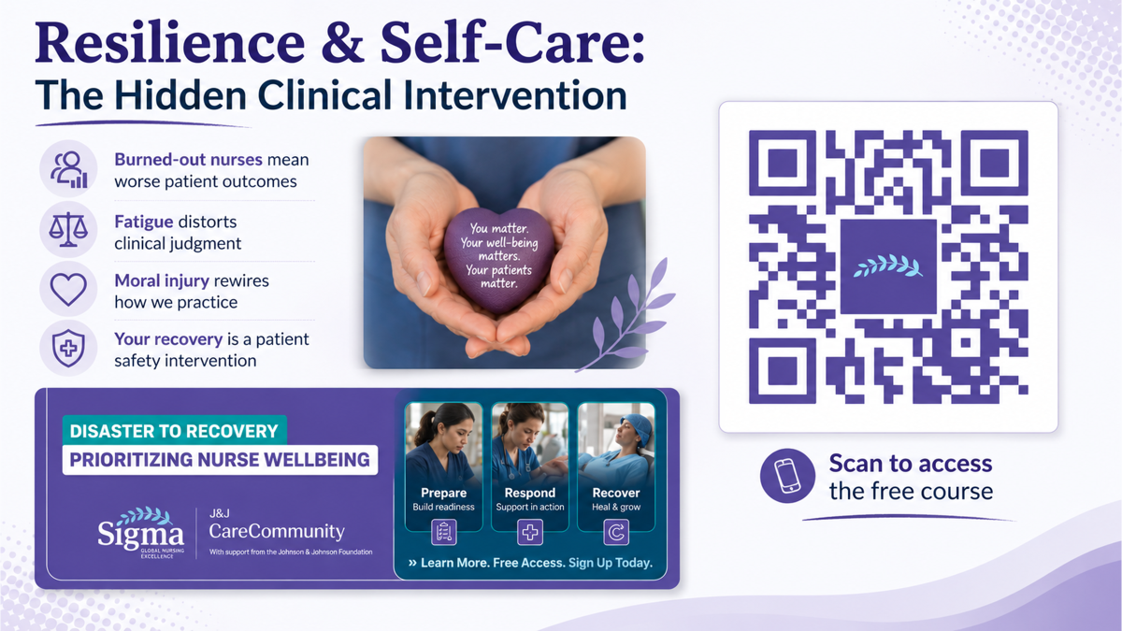
Notes:
This is a free course that is 100% online and comes with a workbook that anyone can access, but I created it for nurses through a grant with Sigma International Nursing Honor Society and the company, Johnson & Johnson. Please scan the QR code to get free access and Nurses can get continuing education credits.

Slide 15

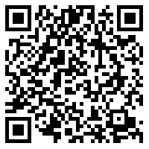
Stay Connected
Notes:
Lastly, please stay connected. For this presentation including detailed notes and a list of resources, please scan that QR code which will take you right to my website, where you can access it for free, as well as review other educational materials.

Slide 16
References
Mental Health & Psychosocial Support – WADEM
Psychological first aid
Mental Health Resources | Mental Health | CDC
Psychological First Aid (PFA): Guide, Examples, Training
Mental Health Resources
RESOURCE LIBRARY - The Mental Health Coalition
Learn: Psychological First Aid (PFA) and Skills for Psychological Recovery (SPR)
Mental Health Information - National Institute of Mental Health (NIMH)
Psychological First Aid: Field Operations Guide - PTSD: National Center for PTSD
Mental Health Resources to Support Adolescents | HHS Office of Population Affairs
Mental Health Resource Directory
Mental health resources for supporting employees – Work for Good
Resources for employees - Workplace Strategies for Mental Health
Essential Mental Health Resources for Employees: A Complete Guide | Simply Psychology
Workplace Mental Health - Employer Resources

